Slide 1

Using RStudio and GitHub for Reproducible Science

Slide 2
AGENDA
Importance of Reproducible Science
Project Organization
Rprojects and GitHub
Connecting to GitHub

Slide 3
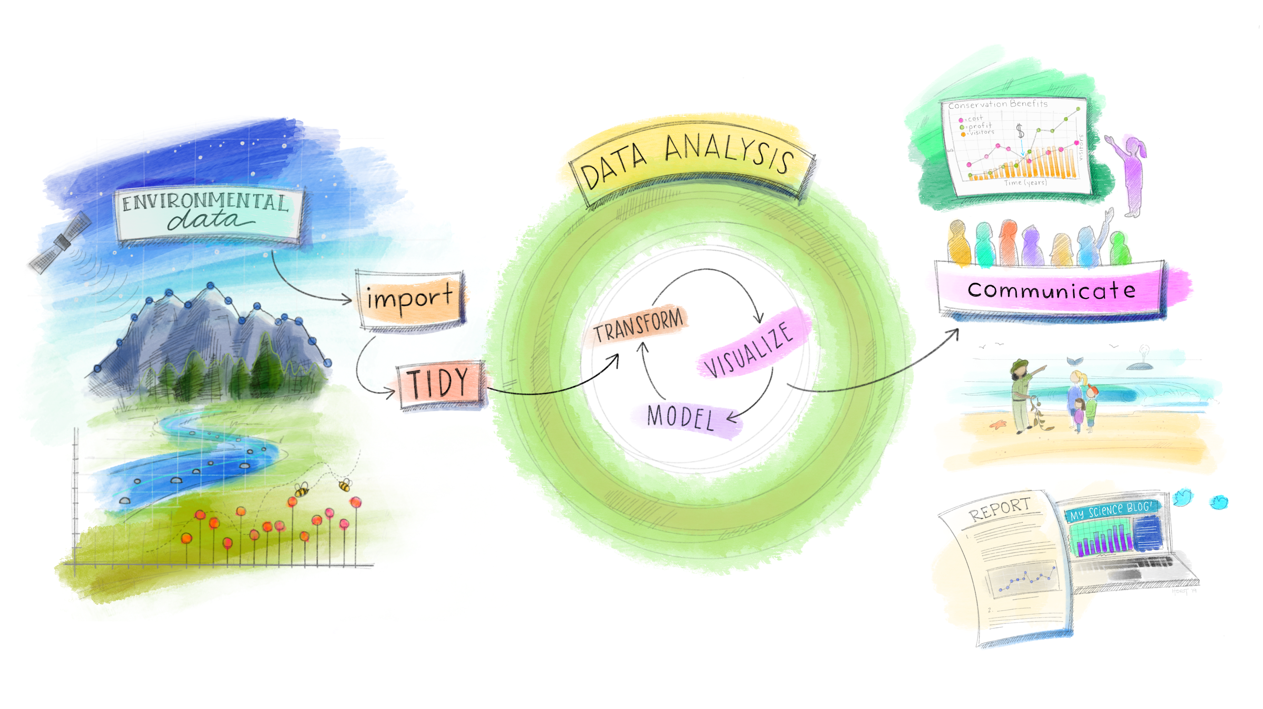
Importance of Reproducible Science
“Reproducibility is a pillar of the scientific method” – Dr. Picardi
Being proficient in the use of programming tools and effectively apply them to store, process, manage, analyze, and visualize data have become must-have skills to take part in the scientific discourse.
Artwork by Allison Horst

Slide 4
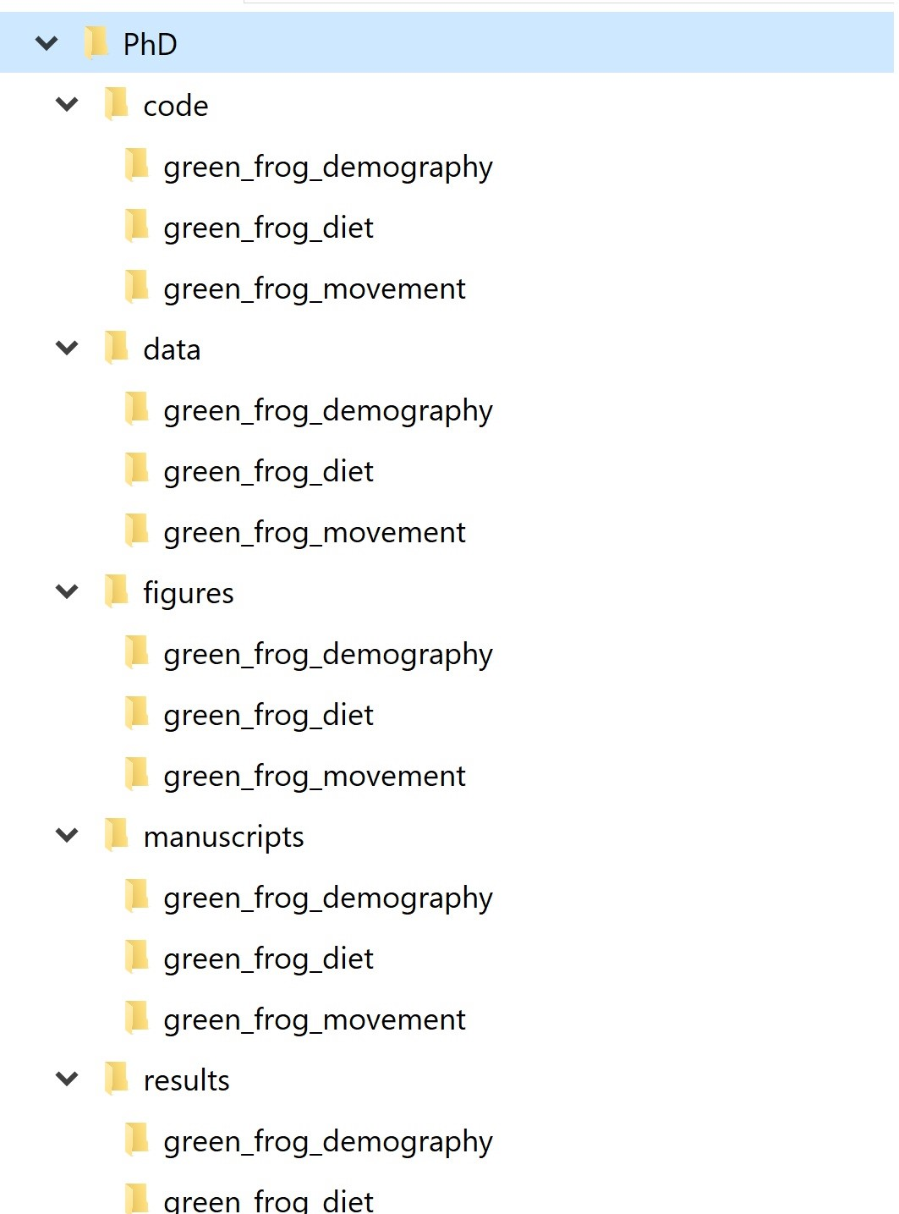
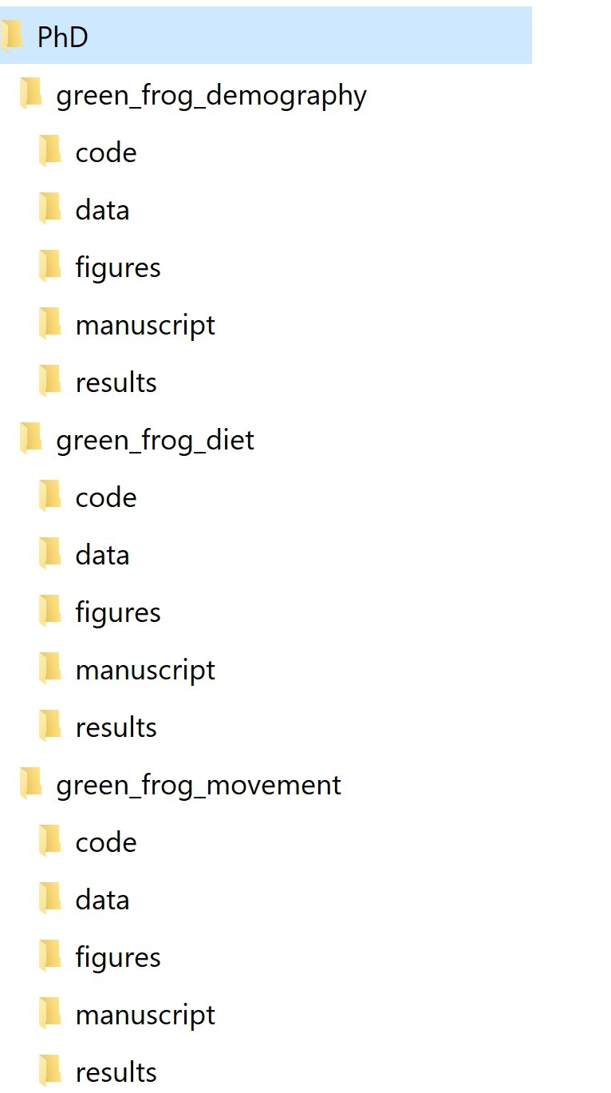
Project Organization
Everything meaningful in one folder structure
Folder Structure
Project-based
Activity-based
File Naming

Slide 5
Golden rules
Raw data should never be changed. Save it into a “data” folder and treat it as immutable. You can even set it as read-only to make sure there is no room for accidents.
The processed, clean version of your data will go into a dedicated “processed_data” folder.
Anything that can be generated from code goes into its own folder. This includes basically everything but the raw data and the code itself. You can have an “output” folder, or separate folders for output files and figures (e.g., “output” and “figures”)
If there are text documents, put them in their own folder (e.g., “docs”)
Code also has its own folder. If you write a lot of functions, it can be helpful to have a “funs” folder to store those and a “src” (for ‘source’) folder to save processing/analysis code.
If processing/analysis scripts are meant to be used in a certain order, you can number them (more on this in a minute). Sometimes the pipeline is not linear but branched, so numbering may not always make sense. Function scripts should not be numbered.
Modularize your code: instead of having a giant script to run your entire analysis from data cleaning to final figures, break up your workflow into several short, single-purpose scripts with well-defined inputs and outputs.

